Slide 1
State Farm Issue Tracker
By Roy Midence, Joseph Ogden, Hadia Majed

Slide 2
Problem Statement
State Farm is a large company and we are only getting bigger
As we grow, using Jira as an issue tracker becomes more and more expensive
We should look into an in-house solution or alternatives
A cheaper solution that won't change much with our growth would be optimal

Slide 3
Business Case
Description
The current bug tracking system used by the company, Jira, is taking a toll on the company financially. We need to create a new system that works better for us.
Benefits
Creating our own bug tracking system for the company will make our way of handling issues more aligned with company goals. We’d also be able to closely monitor the system to ensure it stays up and running.
Scope
It’ll take us about a month and a half to complete the project, employee training included and will run us $148,290 to complete the implementation.
Projected Financial Results
1st Year ROI - $287,460. $435,750.00(Jira) - $148,290(Implementation)
Payback Period -4 months. $148,290/$36,312.50 = 4.1

Slide 4
Business Case (continued)
Risks
It is possible that we do not have a successful implementation of our own hardware and that our in-house system will come with its own errors that we will have to work through. We do already have a strong security team so there's no need to worry much about that.
Alternatives
Besides creating an entirely new database and bug tracking system for the company, there are free bug tracking software programs we can use.
Review
For a benchmark, we can compare the turnover rate for fixes and see how our employees handle the new system.

Slide 5
System Requirements
Input
Issue Tracking System - need to be able to create and manage issues
Project System - A way to keep track of projects and their tasks
Dashboard System - Snapshot of information regarding issues
User System - Determines who has permissions to assign or receive work
Process
An issue is reported and a ticket is filled out with the information
A project is created and information on tasks is filled out
A report is created during an update to an issue or project
Performance and controls
Admin assigns work to staff member
Staff updates status on ticket as project progresses
Mark issue or project as complete
Show when tickets were open or closed
Output
Issues and their statuses, projects and their completion status
Reports on both projects and issues

Slide 6
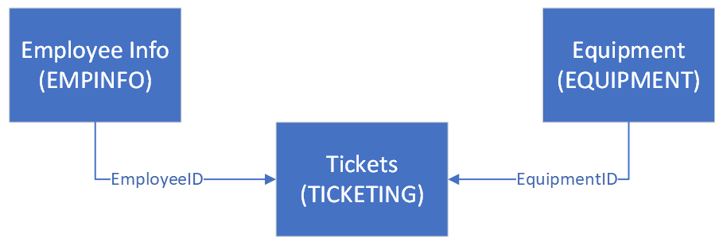
Data Flow Diagram

Slide 7
Database Design
TICKET
TicketID
EmployeeID
Name
Summary
Priority
Description
Status
Type
EquipmentID
EMPINFO
EmployeeID
FirstName
LastName
Address1
Address2
City
Satte
ZipCode
PhoneNumber
Email
EQUIPMENT
EquipmentID
PurchaseDate
EquipmentType
EquipmentName
EquipmentLocation

